Slide 1
BIS3071/BIS2151 Programming
Tutorial 5
Summmer Term SS24

Slide 2
Overview
Recap
Exercise Exception Handling
Exercise Inheritance advanced
Questions about Assignment

Slide 3
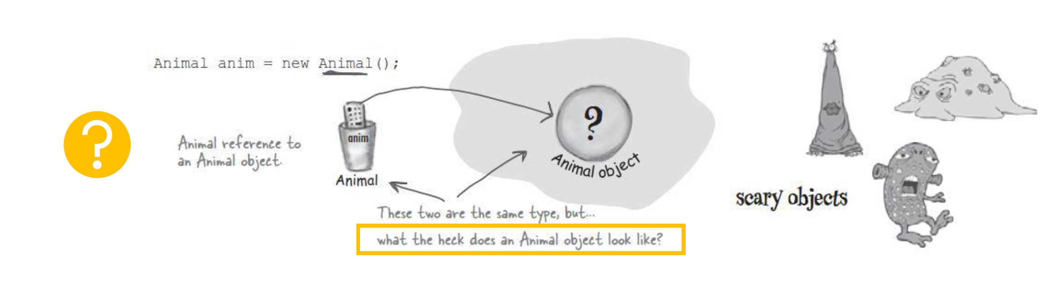
Unidentified Objects

Slide 4
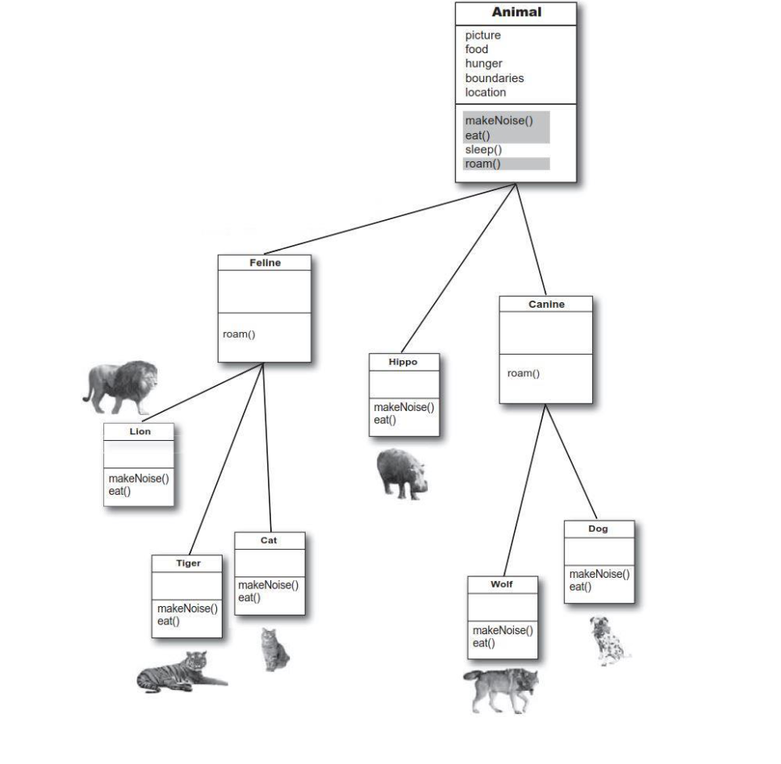
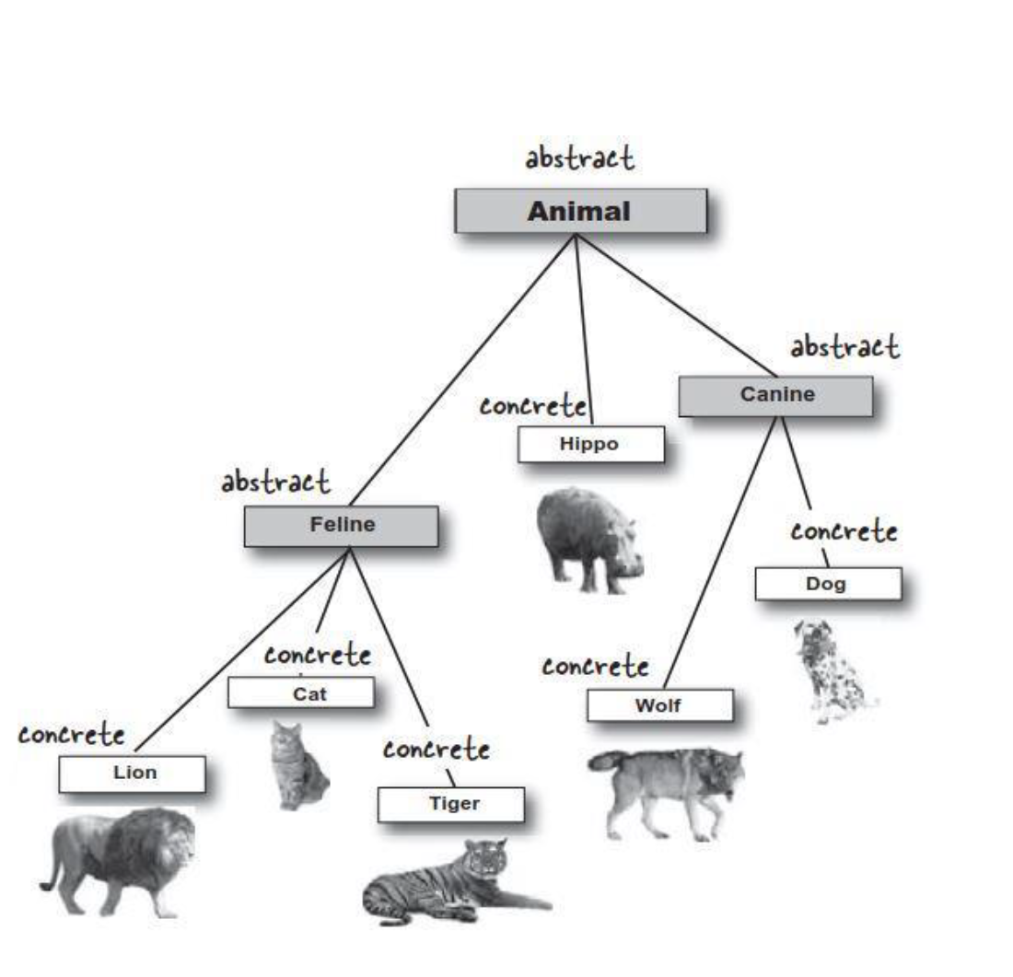

Inheritance tree

Slide 5
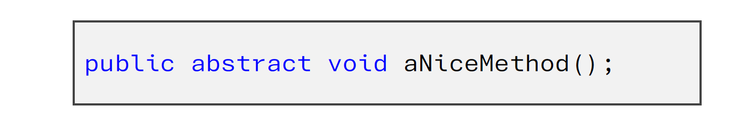

Abstract methods
Abstract methods never have a body
They have no use unless class is extended
No instantiation possible

Slide 6
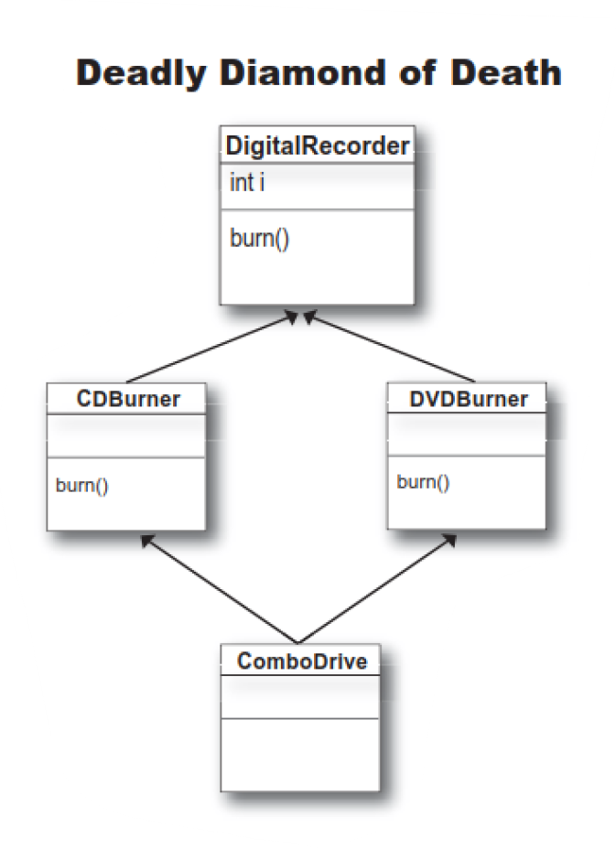
Multiple Inheritance?
Deadly Diamond of Death

Slide 7
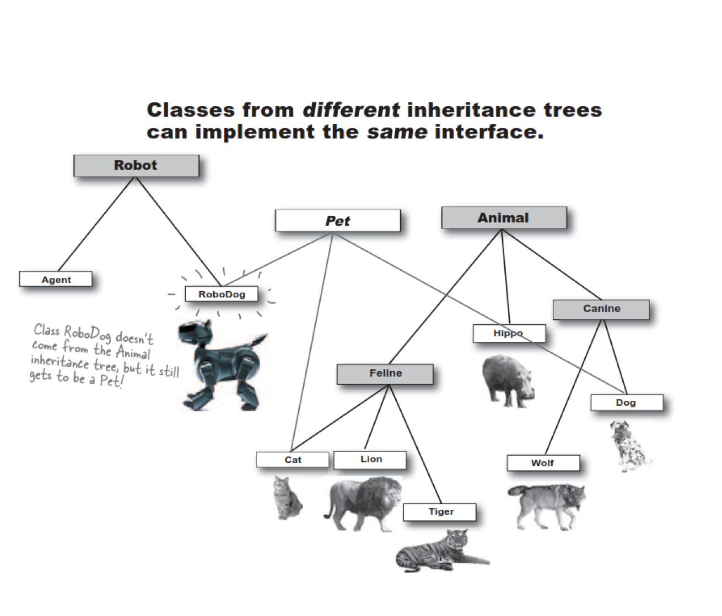
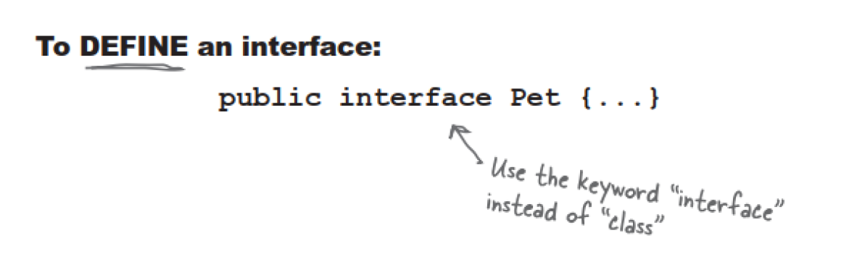
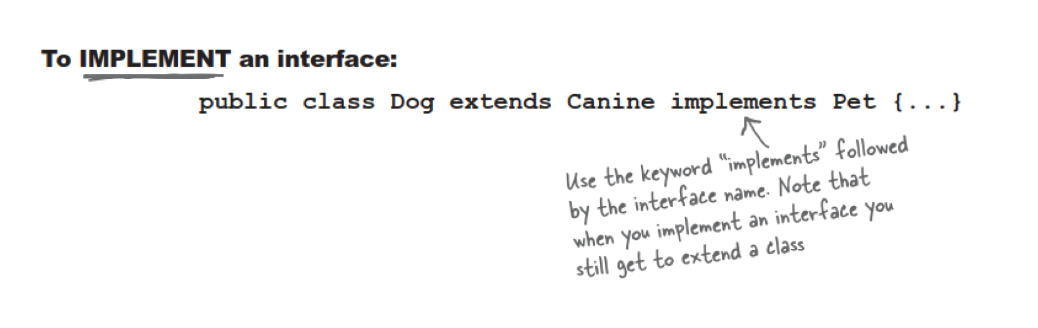
Solution: Interfaces

Slide 8
Inheritance
How could inheritance be built into the cat programme? Code it.
Make use of an abstract class in your inheritance tree.
Your cat should be a pet and get some methods from another class called Pet. (Hint: Why is inheritance not possible?) Code it.

Slide 9
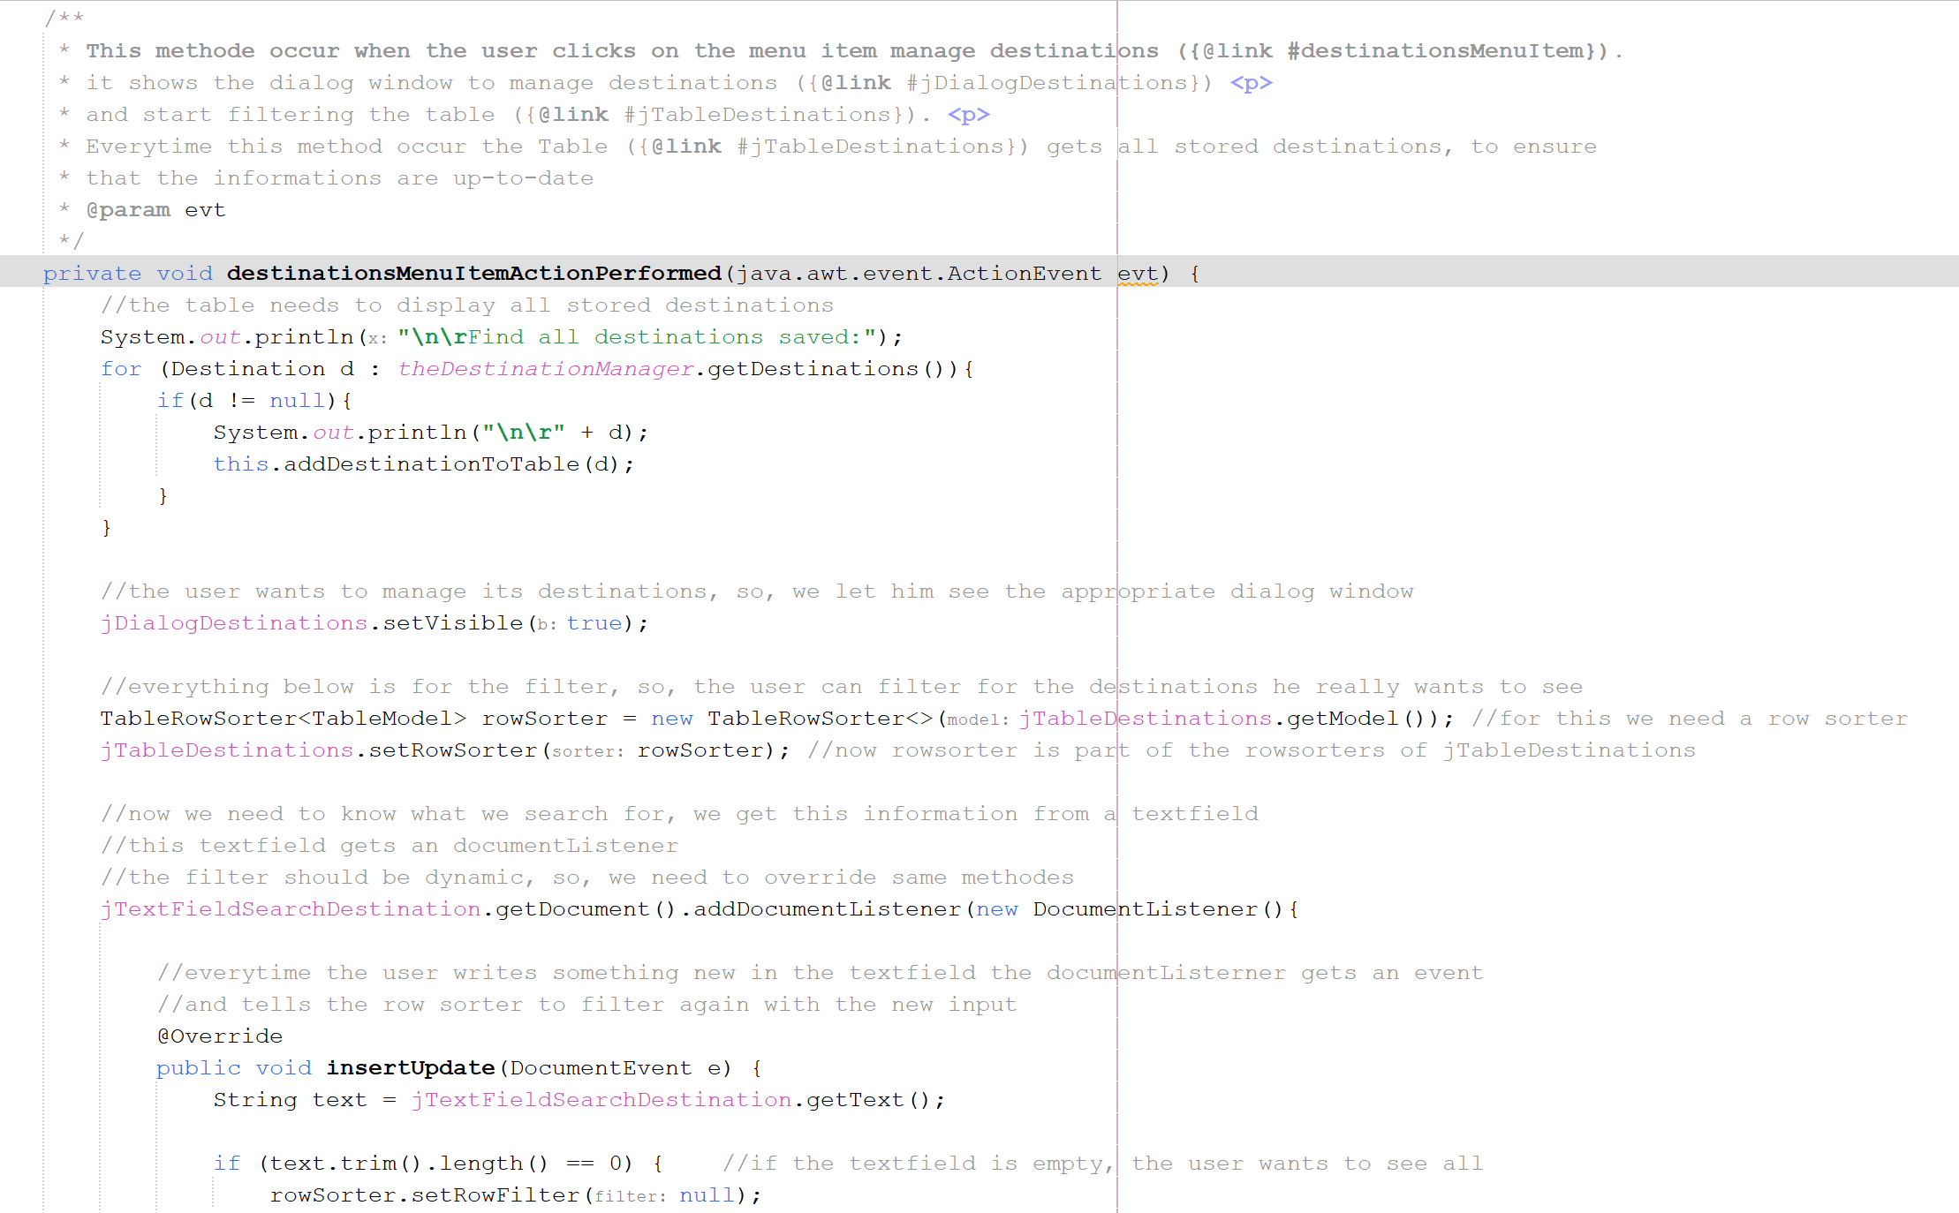

Slide 10
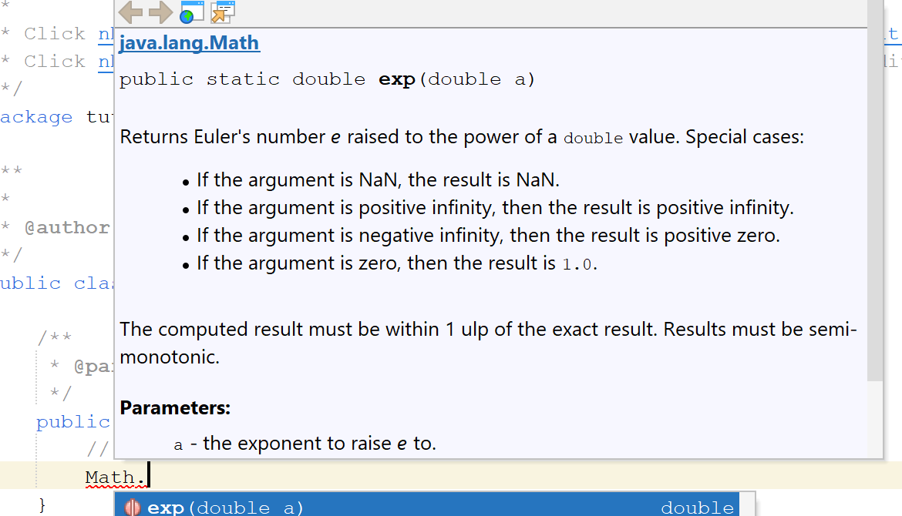
Why do we use JavaDoc?

Slide 11
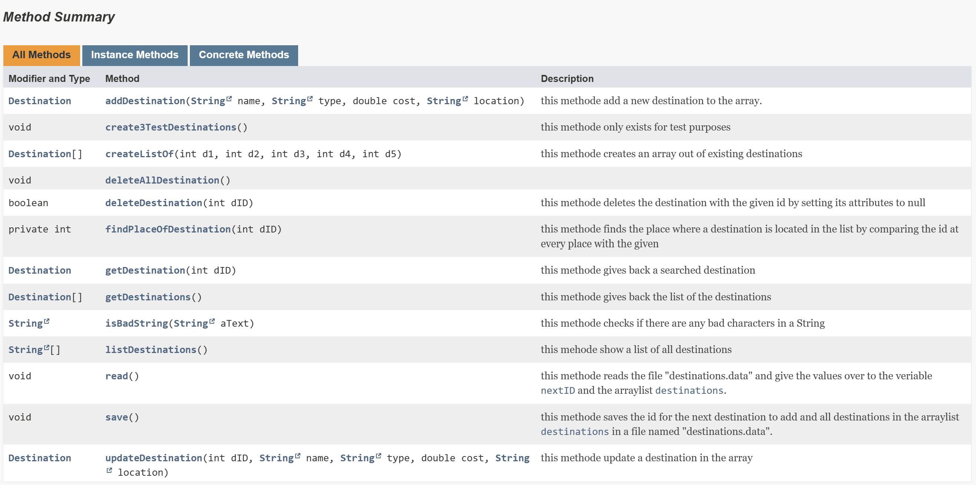
Why do we use JavaDoc?

Slide 12
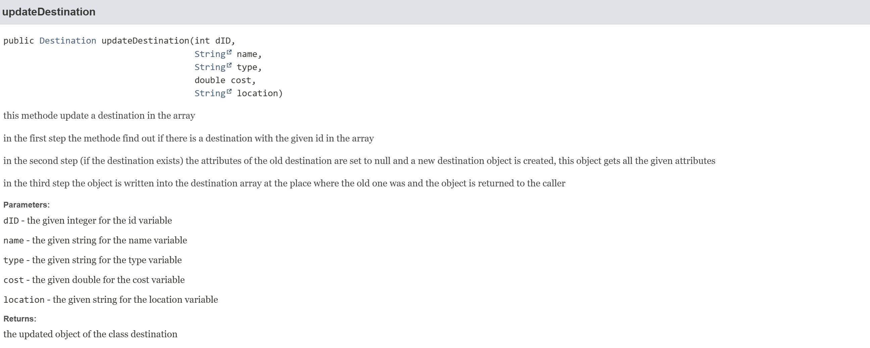
Why do we use JavaDoc?

Slide 13
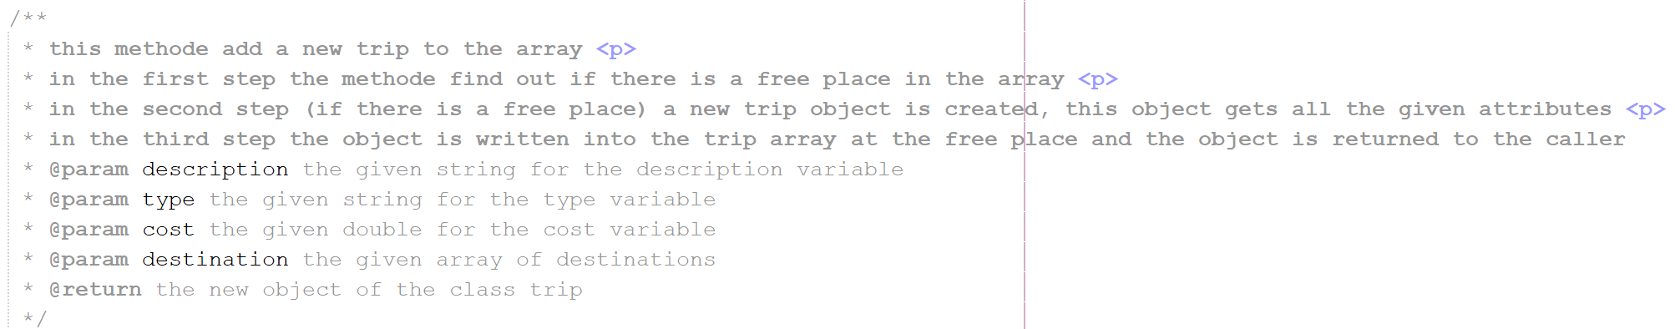
How do we add JavaDoc to our code?

Slide 14
Extract of the tags
@author | Adds an Author entry with the specified name text to the generated documents when the -author option is used.
@param | Adds a parameter with the specified parameter-name followed by the specified description to the Parameters section.
@return | Adds a Returns section with the description text.
@link | Inserts an inline link with a visible text label that points to the documentation for the specified package, class, or member name of a referenced class.
@throws | The @throws tag adds a Throws subheading to the generated documentation, with the class-name and description text.
@see | Adds a See Also heading with a link or text entry that points to a reference.
[https://docs.oracle.com/javase/8/docs/technotes/tools/windows/javadoc.html]

Slide 15
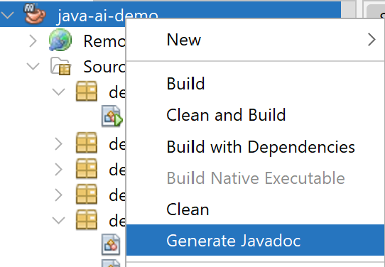
How to generate JavaDoc

Slide 16
Types of Comments
Single-line Comments
//
Multi-line Comments
/*
*/
JavaDoc
/**
*
* */
Shortcut:
[ctrl]+[shift]+[c]

Slide 17
Exercise Exception handling & Scanner
Create a method within a new class called „Training“. The method should take two integers as input from the console.
Use specified Exception Handling in case an error occurs.

Slide 18
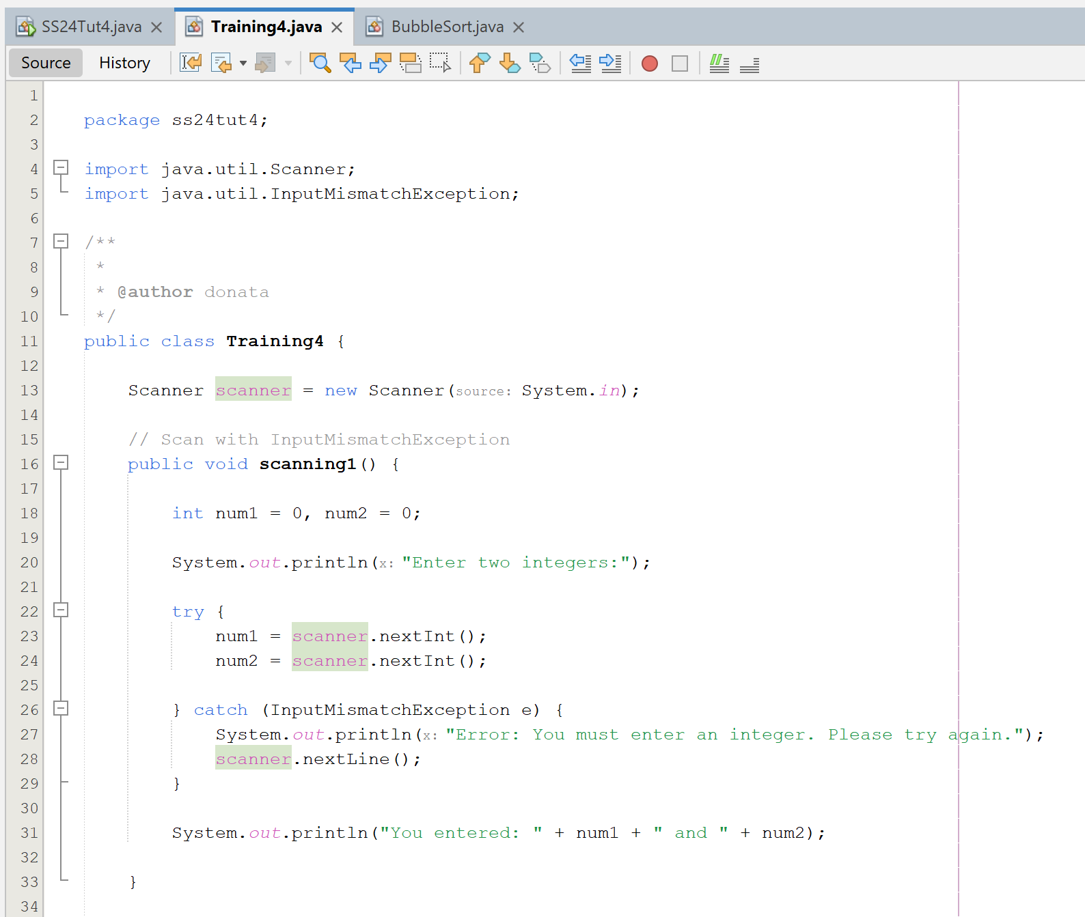
Example Solution
Also possible to use the NumberFormatException in combination with Integer.parseInt()

Slide 19
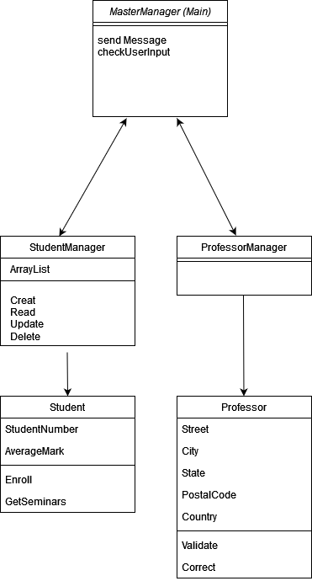
Hints Assignment 02
Example Structure of Manager classes:
Don‘t forget: Classes serve as a Blueprint for objects.

